Slide 1


Slide 2
Comprehensive Digital Marketing
Project Work
Apollo hospitals

Slide 3
Project submitted by :
Team leader : Neha sridevi Modugu
Team members:
CHAVALA PAVANI
KAVYASREE GUDLA
KAKARA KAVYA
VINEETHA KOTANA
K RUCHICHA
M KOUSALYA
HARSHITHA MANDE
MD NOORJAHAN
NAMMI NIROSHA

Slide 4
Certificate:
This to certify that this skill based internship project report submitted in
partial fulfillment of requirement for the award of bachelor's degree in
commerce is a bonafied project done Ms. M NEHA SRIDEVI & team
register no. 120131903015 at her own PC , VISAKHAPATNAM. She has
fulfilled the mandatory requirement for the award of credits and grade

Slide 5
Declaration :
I Ms. M. NEHA SRIDEVI bearing Reg No 120131903015 & TEAM declare that, this skill based
internship project report on “DIGITAL MARKETING INTERNSHIP” on Apollo hospitals out by me
at own my PC at fulfillment of the requirement for the award of
Bachelor’s degree in commerce. This project is original And has been done by me
during the period from 26/05/2023 - 04/05/2023

Slide 6

Introduction:
The company was founded by Prathap C. Reddy in 1983 as the first
corporate healthcare provider in India. Several of Apollo's hospitals have
been among the first in India to receive international healthcare
accreditation by the America-based Joint Commission International (JCI)
as well as NABH accreditation.

Slide 7

Brand ambassador :
Upasana konidela

Slide 8
Part 1: Brand study, Competitor Analysis & Buyer’s/Audience’s Persona
Research Brand Identity:
Mission/Values:We as an organization has ensured to define our five core values i.e. Empathy, Integrity, Responsibility, Unity and Pioneering as a non-negotiable behavioural underpinning for every employee.
USP: Touching lives

Slide 9
Part 1: Brand study, Competitor Analysis & Buyer’s/Audience’s Persona
Analyze Brand Messaging:
We are committed to the achievement and maintenance of excellence in education, research and healthcare for the benefit of humanity”. Tender Loving Care is a way of life at Apollo Hospitals.
Examine the brand's tagline:
To touch someone's life means to have an impact on someone, to affect them in some way. This impact can be positive or n. Continue reading. Vish Agashe. Touching someone's life means making a positive change in someone's life; this change could change emotional state, physical situation or much more.

Slide 10

Part 1: Brand study, Competitor Analysis & Buyer’s/Audience’s Persona
Competitor Analysis: Select three competitors operating in the same industry or niche as the chosen brand, examine their USPs and online community
Competitor 1:
Fortis Healthcare Limited (FHL) is
an Indian multinational chain of private
Hospitals headquartered in India.
Fortis started its health care operations

Slide 11

Competitor 2 :
Aster DM Healthcare Limited is a publicly-traded multinational for-profit hospital conglomerate healthcare company founded by Azad Moopen in 1987.

Slide 12

Competitor 3 :
Medanta – The Medicity is a multi-super specialty hospital located in Gurgaon, India. It was founded in 2009 by renowned cardiac surgeon, Dr. Naresh Trehan.

Slide 13
Part 1: Brand study, Competitor Analysis & Buyer’s/Audience’s Persona
Buyer's/Audience's Persona:
Brand Finance has calculated the brand value of the Apollo Hospitals Enterprise brand twice, in 2014 and 2023. The Apollo Hospitals Enterprise brand valuation has featured in one brand ranking, the best India brands.To find out more about Apollo Hospitals Enterprise brand value, request the Apollo Hospitals Enterprise Brand Value Report.

Slide 14
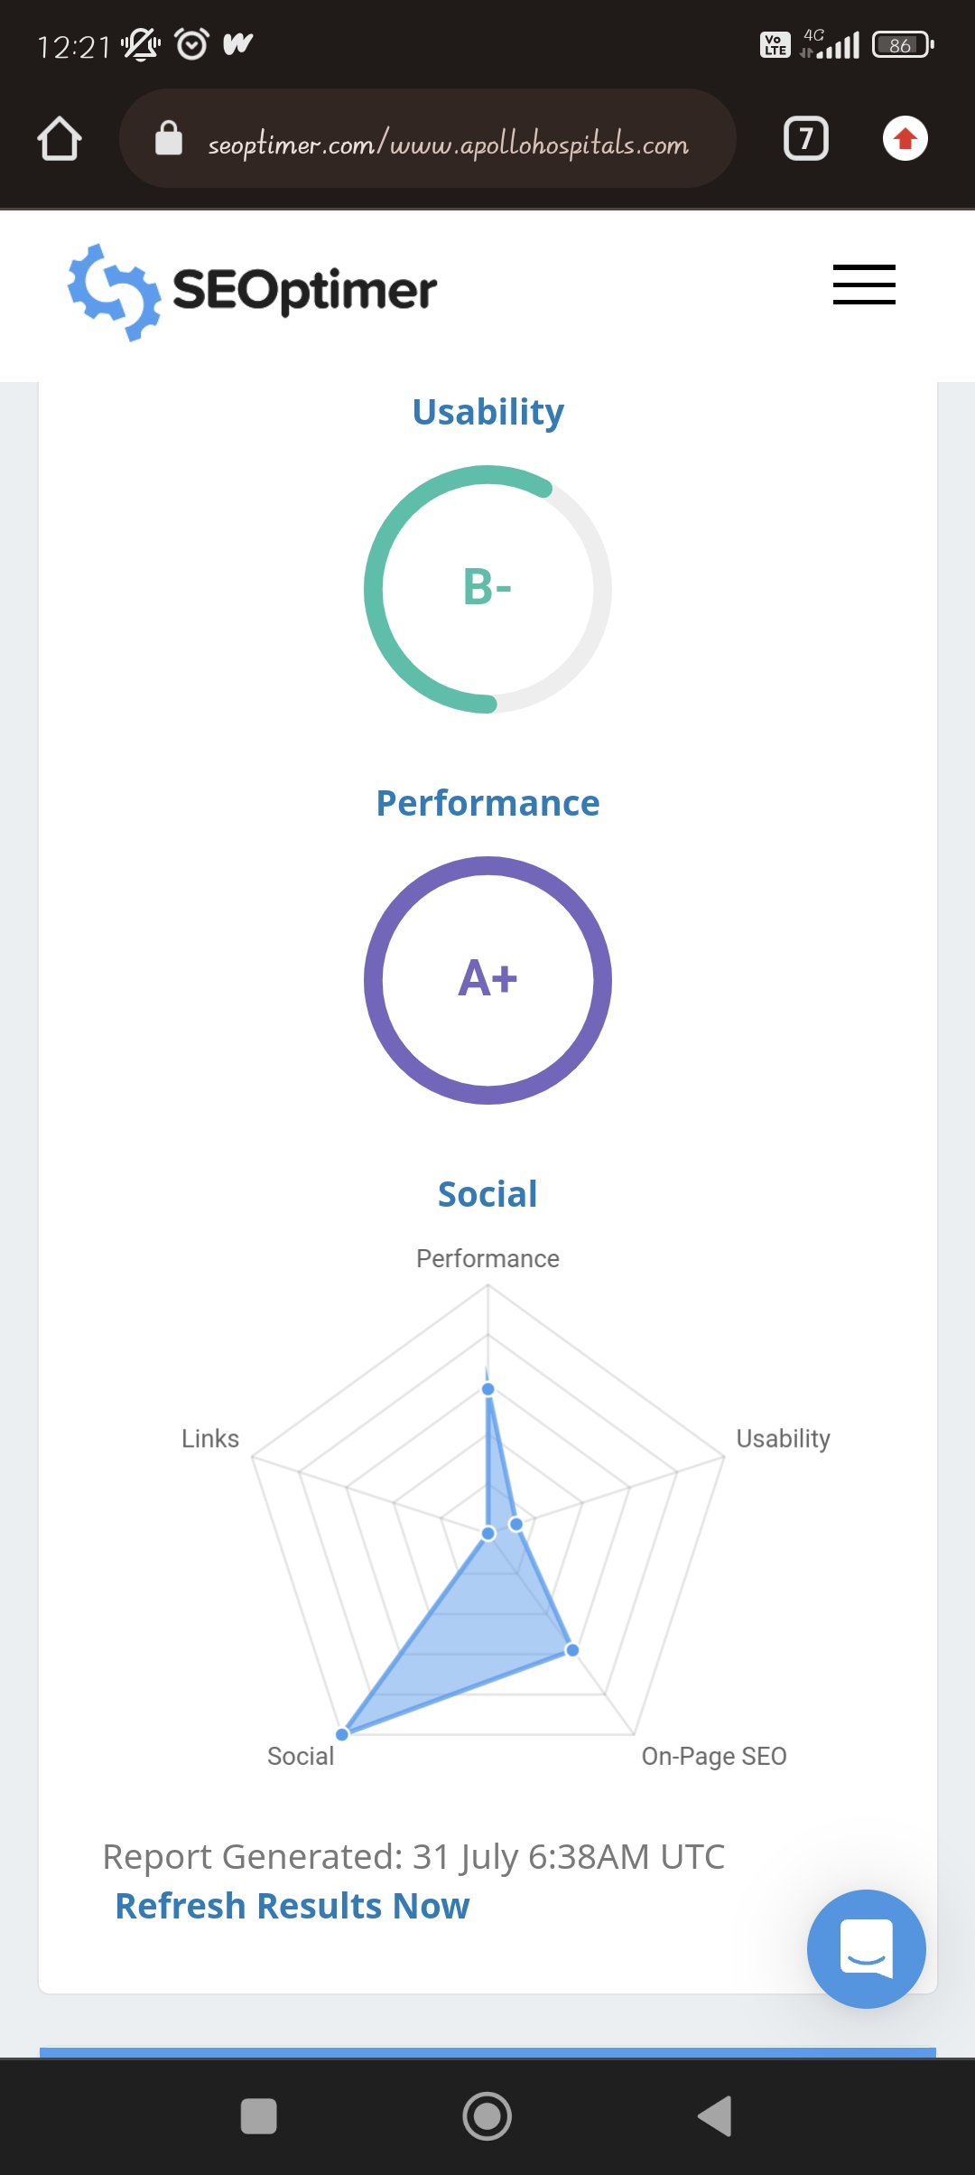
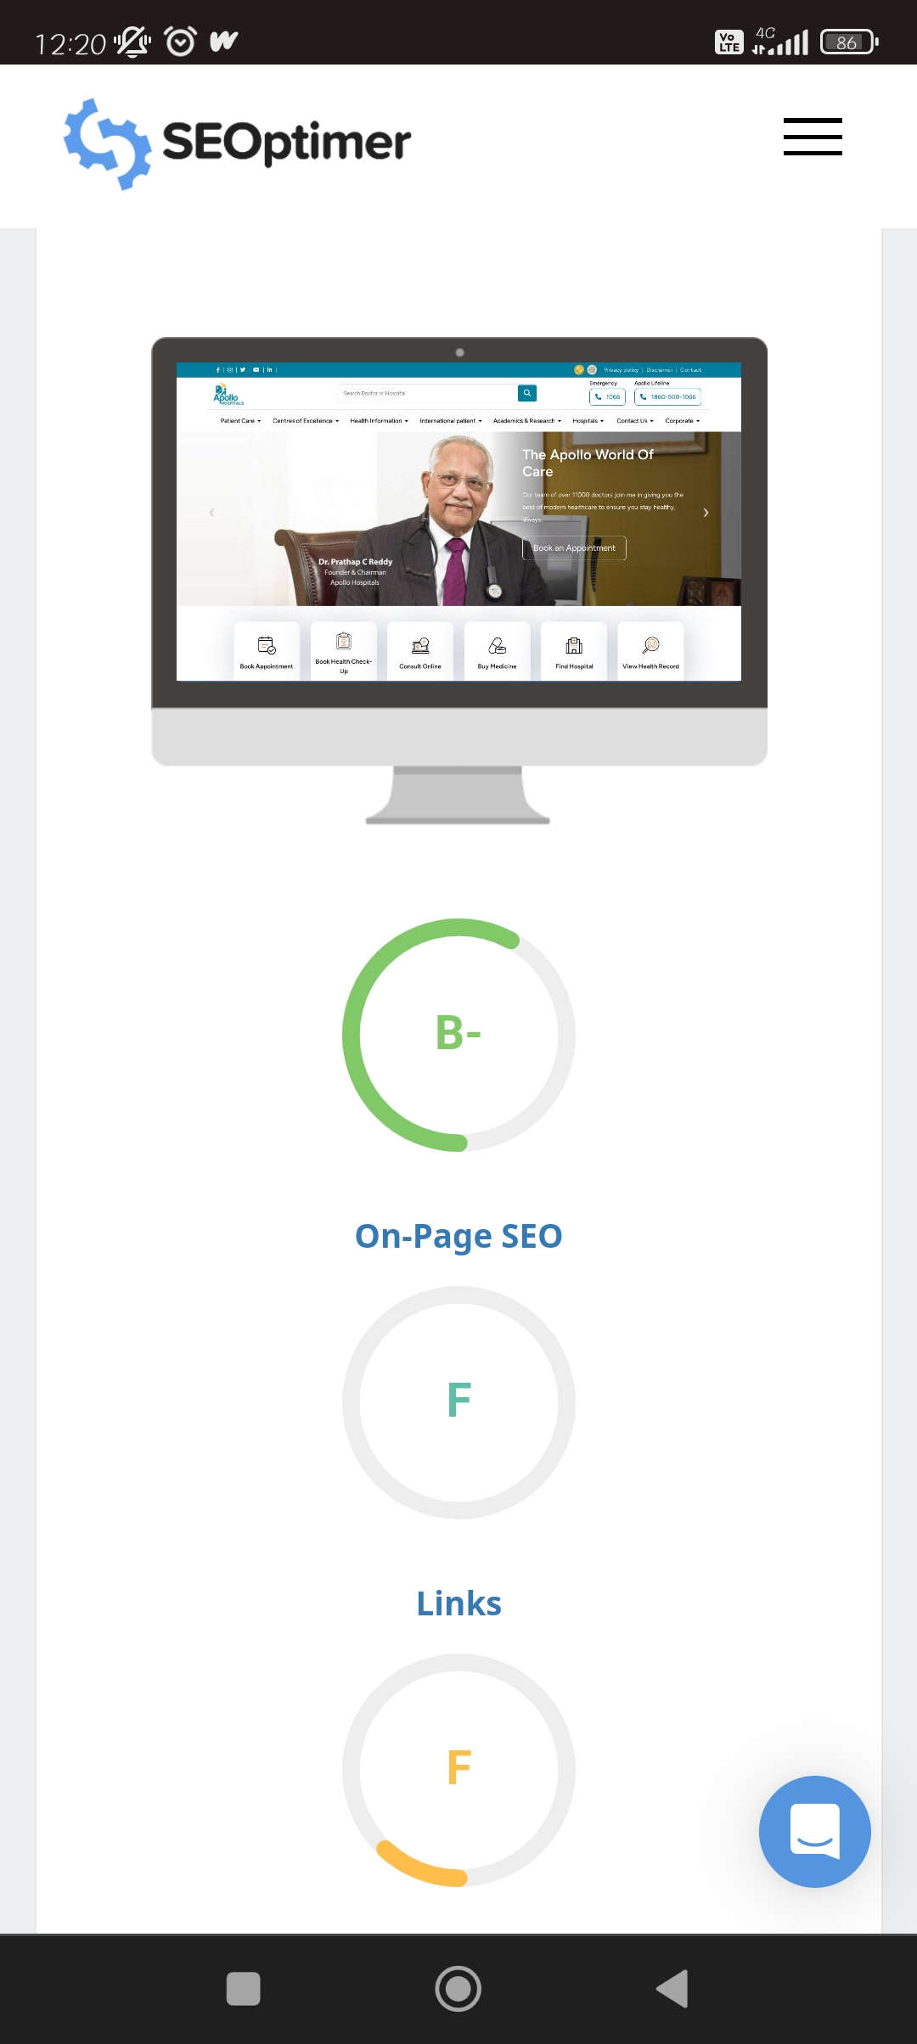
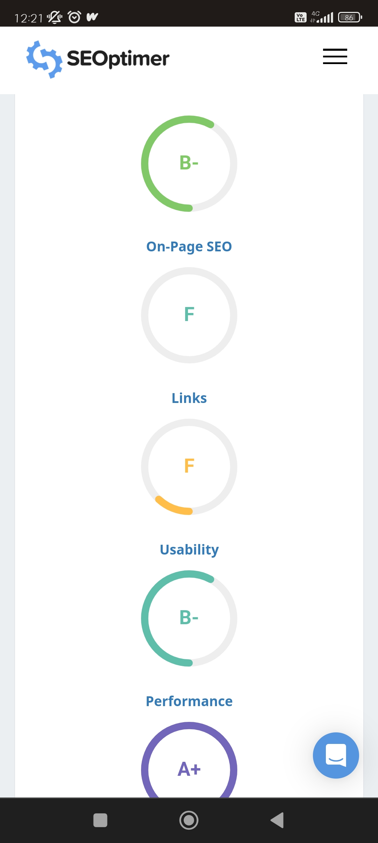
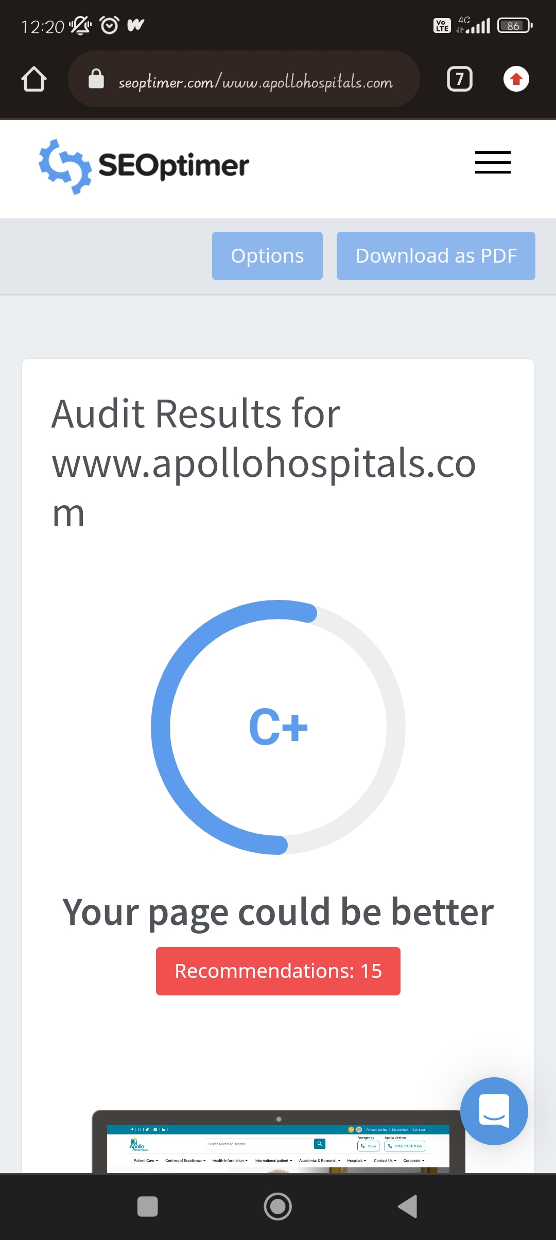
Part 2: SEO & Keyword Research
SEO Audit:

Slide 15
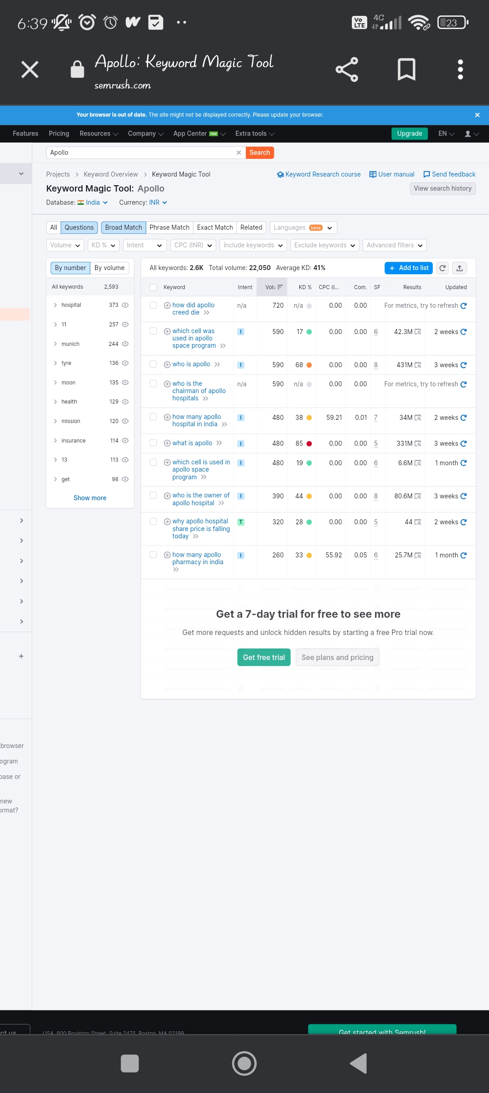
https://www.seoptimer.com/apollohospitals.com/hospital/visakhapatnam/
https://www.seoptimer.com/apollohospitals.com/apollo-in-the-news/apollo-hospitals-leads-indias-solid-multi-organ-transplantation-with-over-23000-transplants-establishes-global-leadership/
Keywords research :
Keywords research
Done by : Neha modugu

Slide 16

• On page optimization:

Slide 17
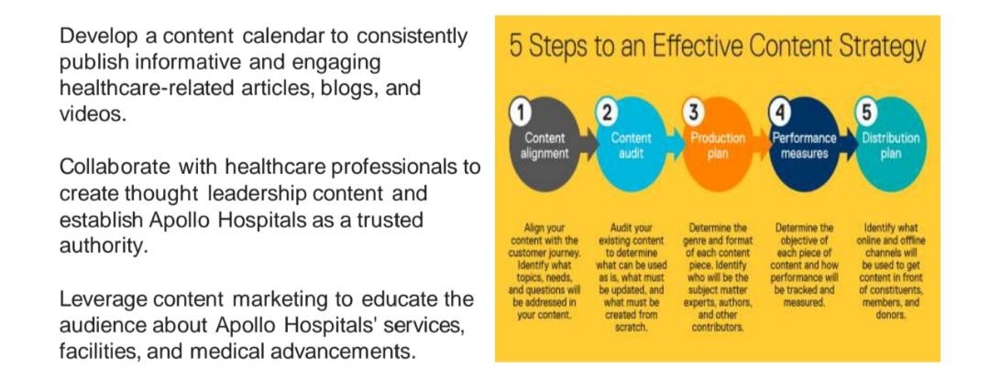
Part 3: Content Ideas and Marketing Strategies
Content Idea Generation & Strategy:

Slide 18
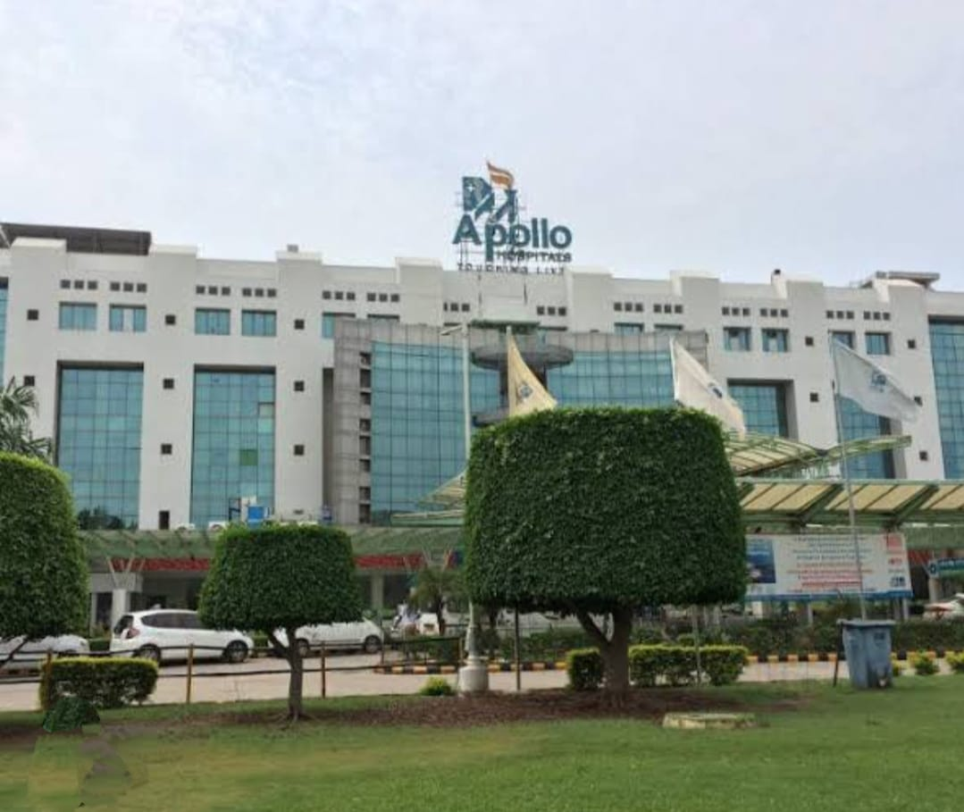
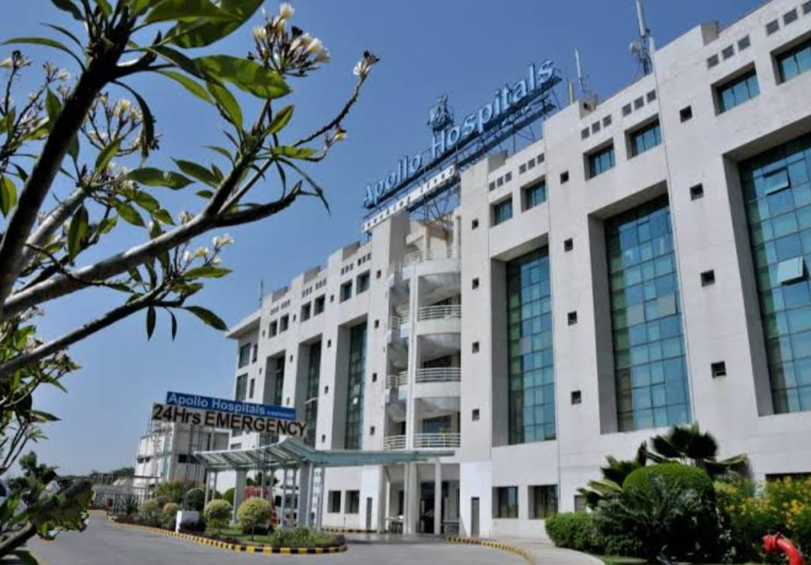
Part 3: Content Ideas and Marketing Strategies

Slide 19
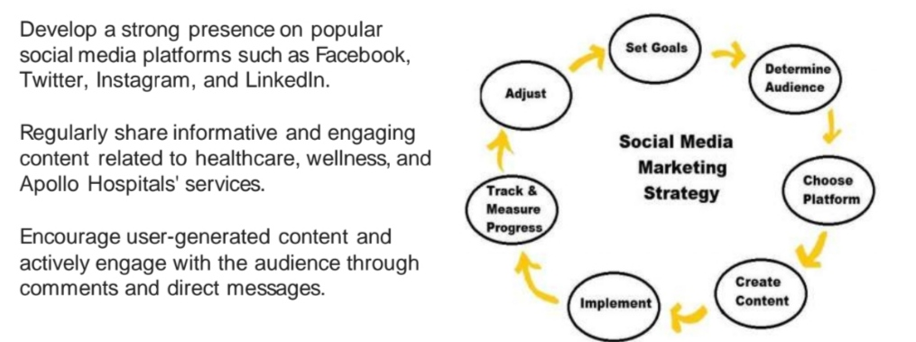
Part 3: Content Ideas and Marketing Strategies

Slide 20
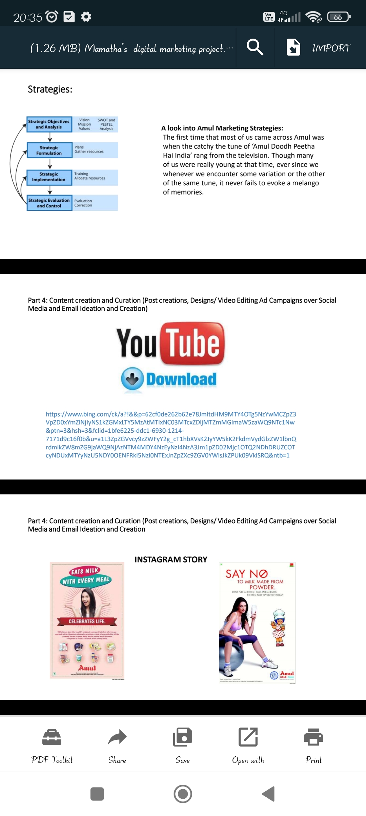
Part 4: Content Creation and Curation (Post creations, Designs/Video Editing, Ad Campaigns over Social Media and Email Ideation and Creation)
Post Creation:
YouTube ad -
https://www.youtube.com/shorts/CvaXkAeAyxp/?ytshorts/EdhRyta=

Slide 21
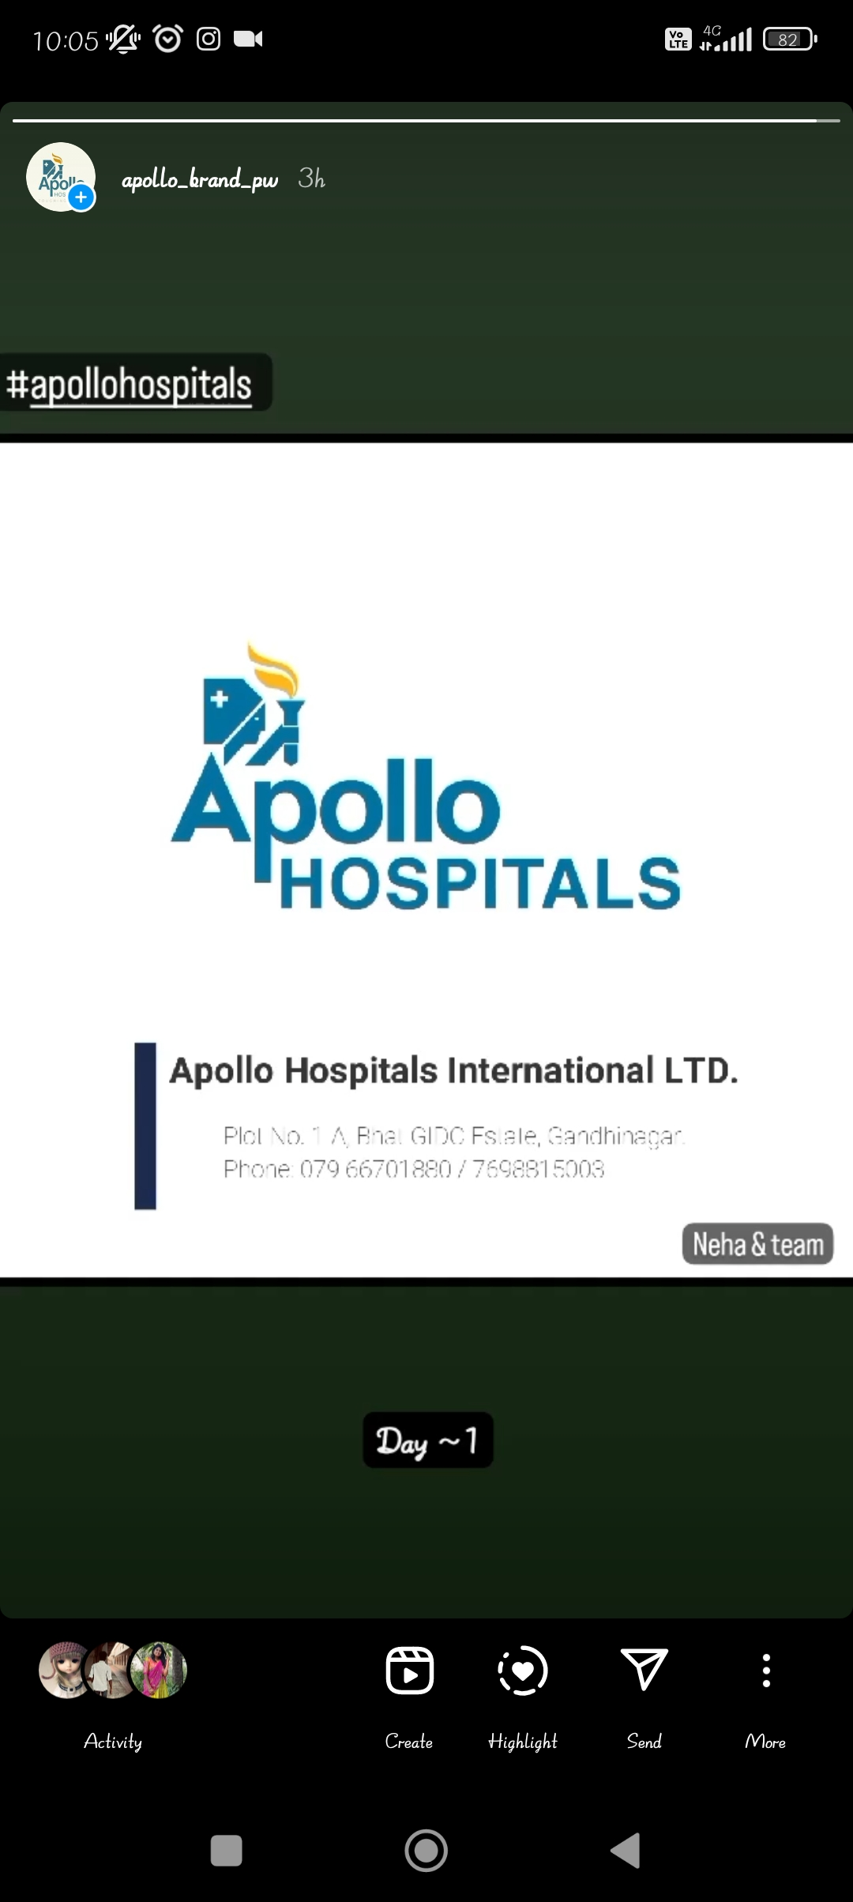
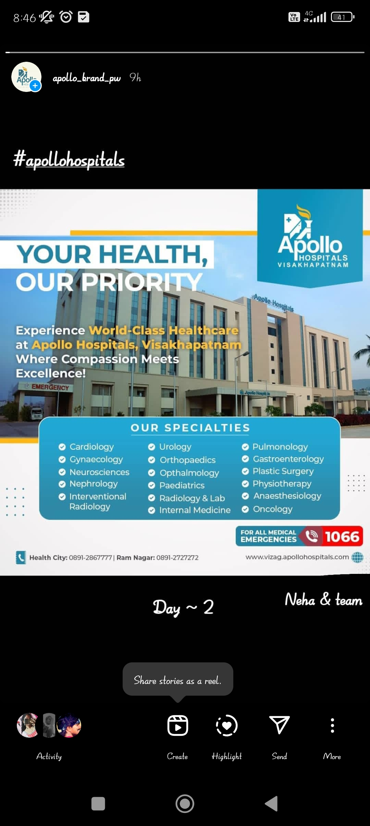
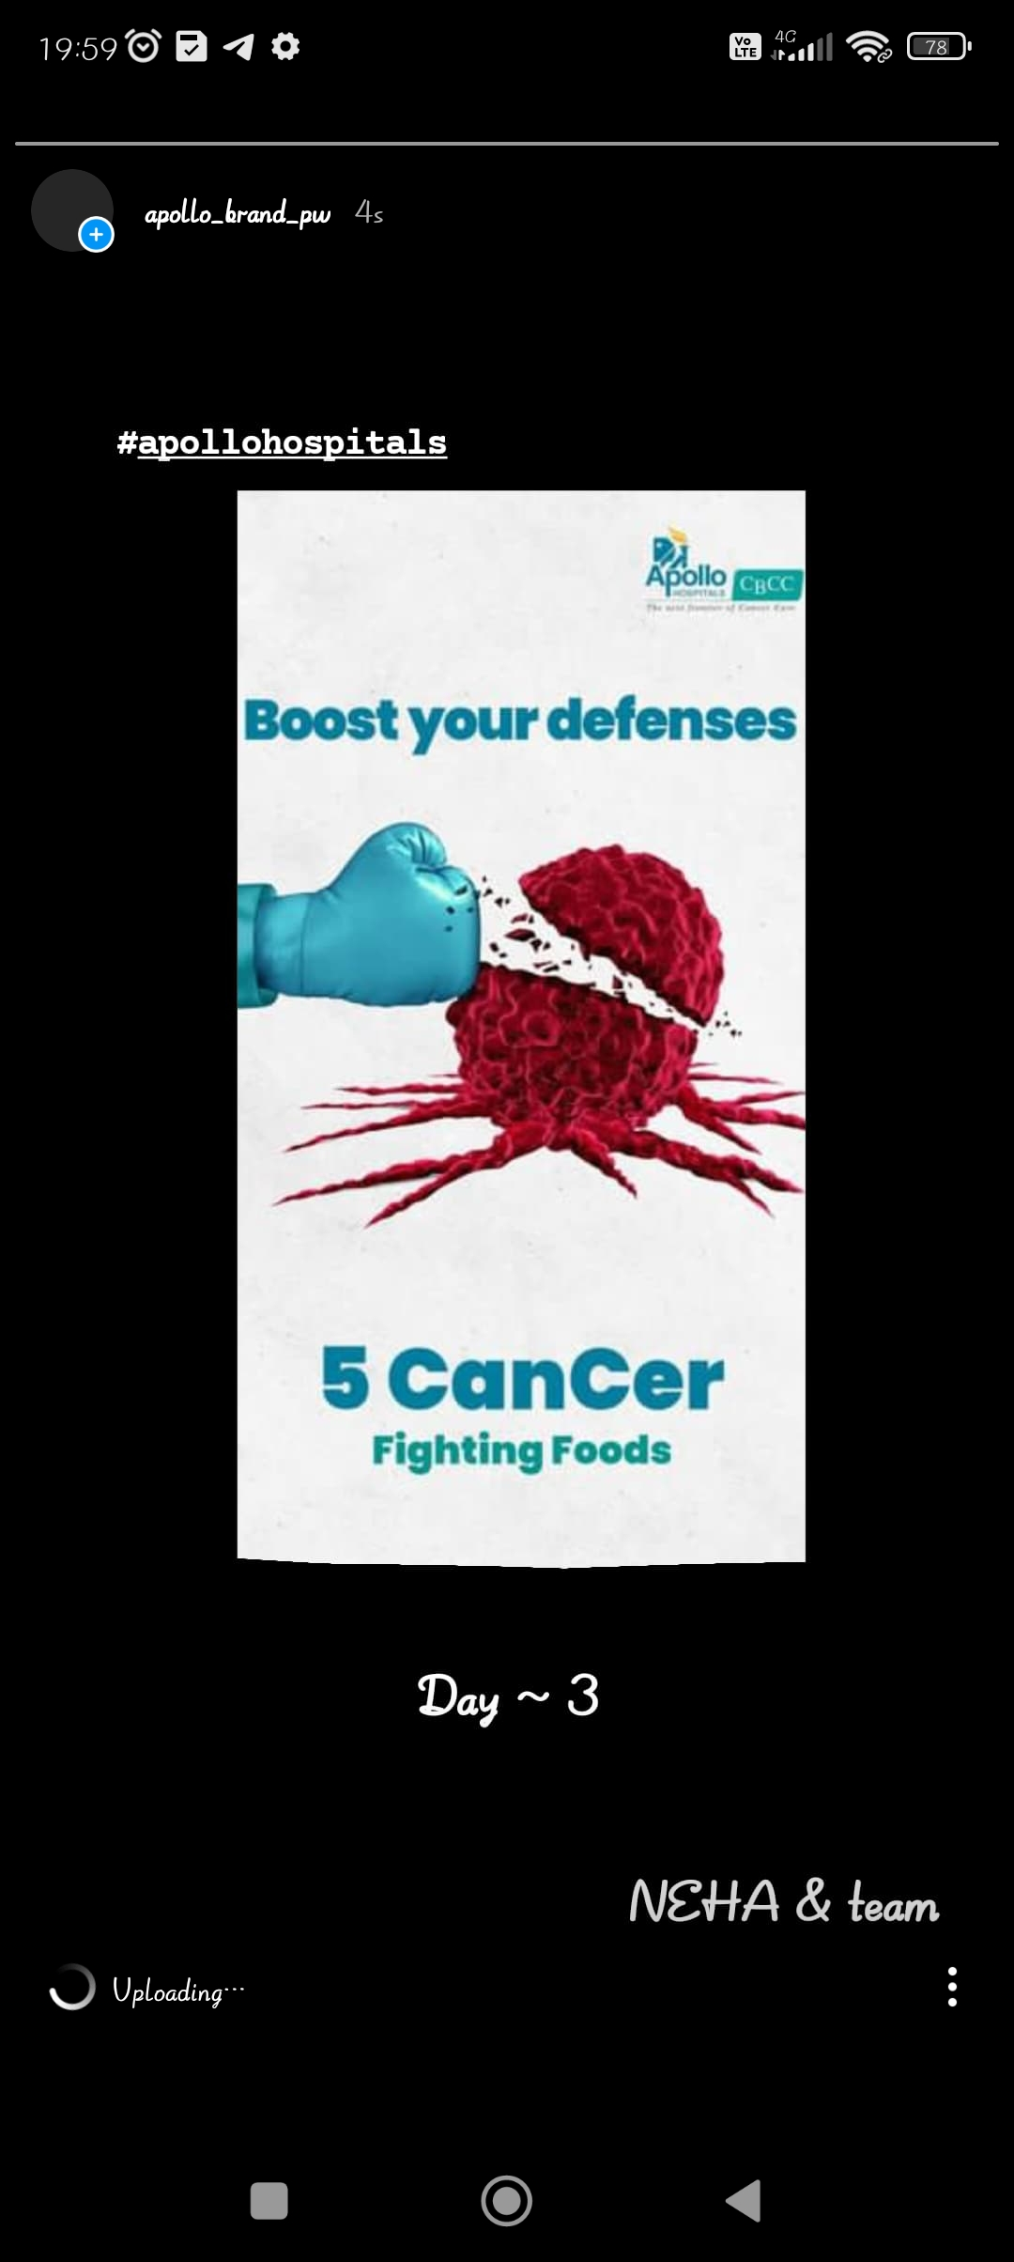
Part 4: Content Creation and Curation (Post creations, Designs/Video Editing, Ad Campaigns over Social Media and Email Ideation and Creation)
Instagram Story

Slide 22
Part 4: Content Creation and Curation (Post creations, Designs/Video Editing, Ad Campaigns over Social Media and Email Ideation and Creation)
Designs/Video Editing
https://www.instagram.com/reel/CvaXkAeAyxp/?igshid=NTc4MTIwNjQ2YQ==
Design Tools Familiarization (use Canva for creating visually appealing graphics)
Video Creation: Utilize VN or any video editor of your choice to create videos related to the chosen topic.

Slide 23
Part 4: Content Creation and Curation (Post creations, Designs/Video Editing, Ad Campaigns over Social Media and Email Ideation and Creation)
Social Media Ad Campaigns
Ad Campaigns over Social Media:
https://www.instagram.com/reel/CvaXkAeAyxp/?igshid=NTc4MTIwNjQ2YQ==

Slide 24
Part 4: Content Creation and Curation (Post creations, Designs/Video Editing, Ad Campaigns over Social Media and Email Ideation and Creation)
For every campaign clearly define:
Advertising Goals: Increase online brand visibility and awareness of Apollo Hospitals among the target audience Drive more traffic to Apollo Hospitals' website and mobile app. Generate leads and increase patient acquisition through digital channels
Audience Targeting: The targeting for Apollo Hospitals has been bang on with 50 percent of audience above 40 years which ensures that their health oriented content actually gets responses. Apollo is a great example of good targeting + good content strategy = effective social media.
Ad Creation: Mission Statement. Apollo Hospitals was established in 1983 by Dr. Prathap C Reddy, renowned as the architect of modern healthcare in India. As the nation's first corporate hospital, Apollo Hospitals is acclaimed for pioneering the private healthcare revolution in the country.

Slide 25
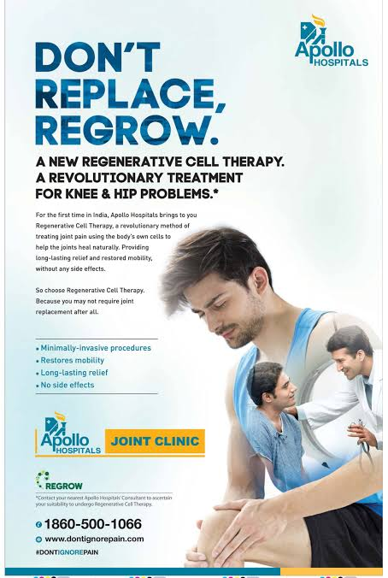
Part 4: Content Creation and Curation (Post creations, Designs/Video Editing, Ad Campaigns over Social Media and Email Ideation and Creation)
Email Ad Campaigns
Ad Campaigns for email marketing:

Slide 26
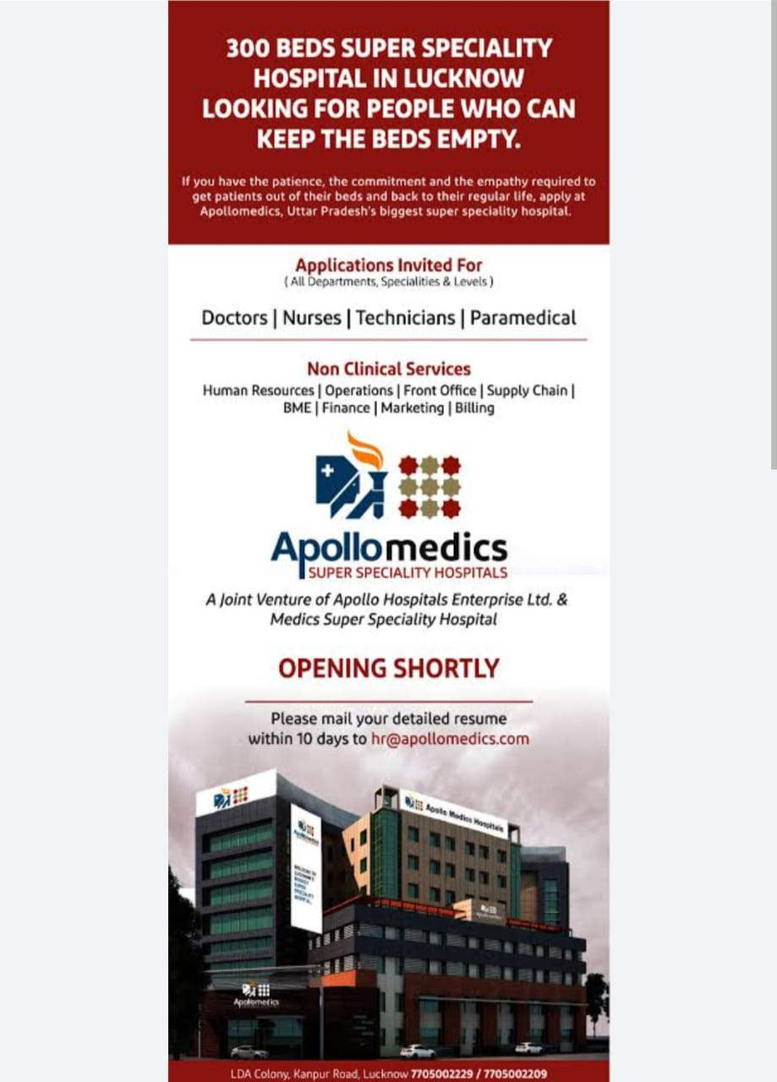
Part 4: Content Creation and Curation (Post creations, Designs/Video Editing, Ad Campaigns over Social Media and Email Ideation and Creation)
Email Ad Campaigns
Ad Campaigns for email marketing:

Slide 27

Email Ad Campaign 1 - Brand Awareness
Apollo hospitals
customer support:
enquiry@apollohospitals.com
info@apollohospitals.com

Slide 28
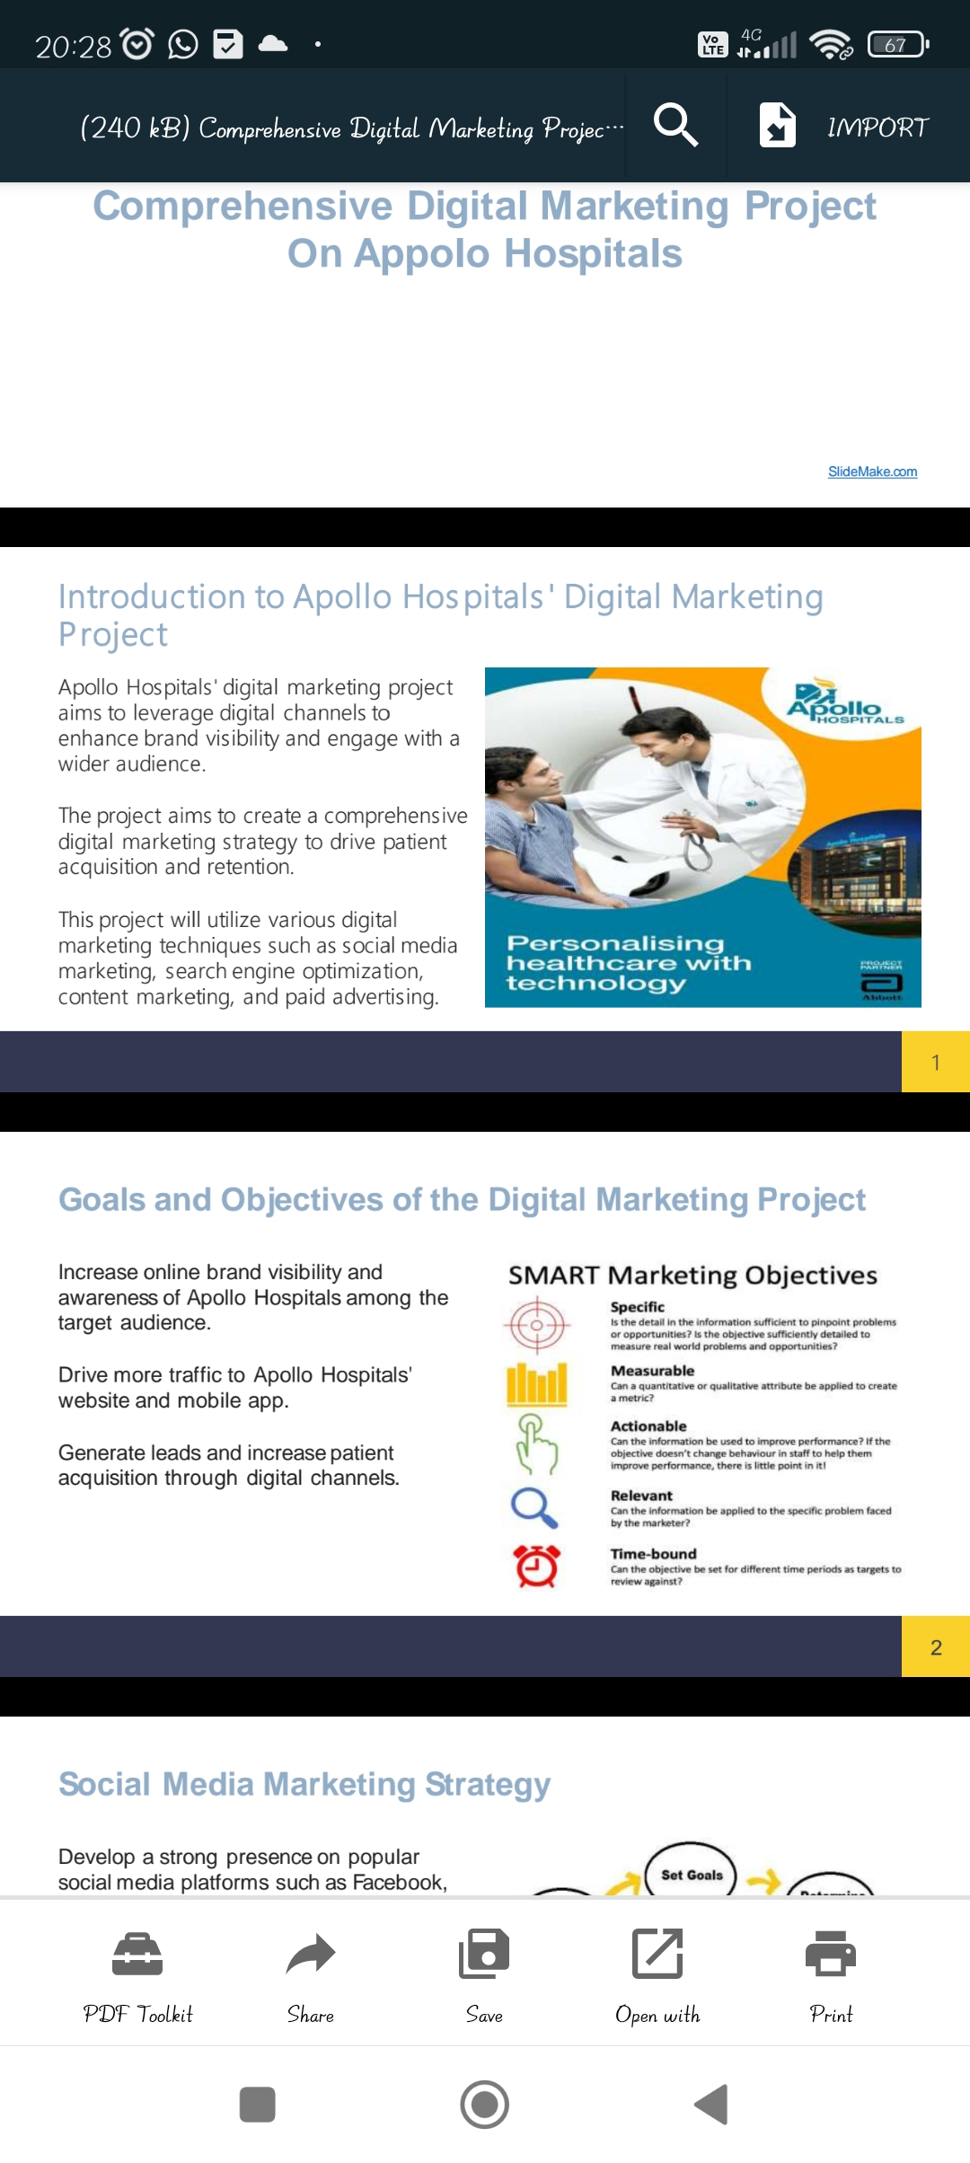
Email Ad Campaign 2 - Lead Generation

Slide 29
Email Ad Campaign 2 - Lead Generation

Slide 30
Part 4: Content Creation and Curation (Post creations, Designs/Video
Editing, Ad Campaigns over Social Media and Email Ideation and Creation)
Implement robust tracking and analytics tools to measure the effectiveness of digital marketing efforts.Monitor website traffic, engagement metrics, and conversion rates to identify areas of improvement.Use data-driven insights to optimize
strategies and allocate resources effectively
The comprehensive digital marketing project on Apollo Hospitals aims to enhance brand visibility, drive patient acquisition, and improve overall online
presence.By leveraging various digital marketing techniques, Apollo Hospitals can effectively engage with the target audience and provide valuable healthcare information.Constant monitoring optimization, and data analysis will ensure the project's success and drive continuous improvement.
Provide an opportunity for the audience to ask questions and engage in a discussion about the comprehensive digital marketing project on Apollo Hospitals.Encourage feedback and suggestions to
further enhance the project's success.

